Slide 1
BlueBerry Wine
Market Research into quality wine production
Notes:
"Today, I’ll cover strategies to improve wine quality and key factors influencing winemaking decisions."

Slide 2
Agenda
Portuguese wine and land information
Is red wine worth it ?
Is the chemical composition of red and white wines comparable?
Does the chemical composition have any impact on the perceived quality of the wine?
What are my observations?

Slide 3
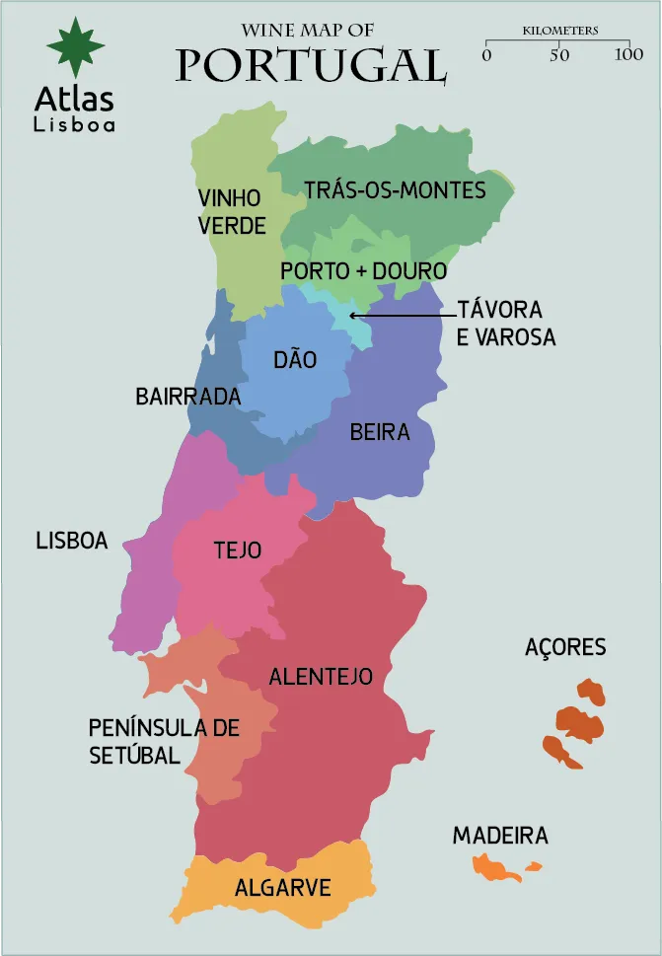
Portuguese Wine And Land Information
Diverse Wine Regions
Unique Grape Varieties
Port Wine and Beyond
Innovative Winemaking
Global Recognition & Value
Wine Tourism
Notes:
Slide 1: Diverse Wine Regions
Speaker Notes: "Portugal’s wine regions, from Vinho Verde to Alentejo, each bring unique flavors, climates, and winemaking styles."
Slide 2: Unique Grape Varieties
Speaker Notes: "With over 250 native grapes like Touriga Nacional and Arinto, Portugal offers distinctive wines unlike any others worldwide."
Slide 3: Port Wine and Beyond
Speaker Notes: "Known for Port, Portugal also excels in reds, whites, and sparkling wines from regions like Douro and Alentejo."
Slide 4: Innovative Winemaking
Speaker Notes: "Portuguese winemakers blend tradition with modern methods, enhancing quality and showcasing Portugal's evolving wine scene."
Slide 5: Global Recognition & Value
Speaker Notes: "Portuguese wines are celebrated for quality and affordability, earning awards and strong global recognition."
Slide 6: Wine Tourism
Speaker Notes: "Wine tourism thrives in Portugal, especially in scenic regions like Douro, offering visitors rich wine and cultural experiences."

Slide 4
Is Red Wine Worth It ?

Slide 5
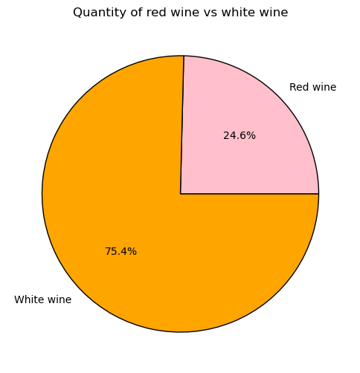
Advantages Of White Wine
Climate Suitability: Cooler regions like Vinho Verde excel at producing fresh white wines, and white grapes adapt better to rising temperatures.
Challenges With Producing Red Wine
Limited Data: Less data available on red wine production, making it harder to identify consistent quality markers.

Slide 6
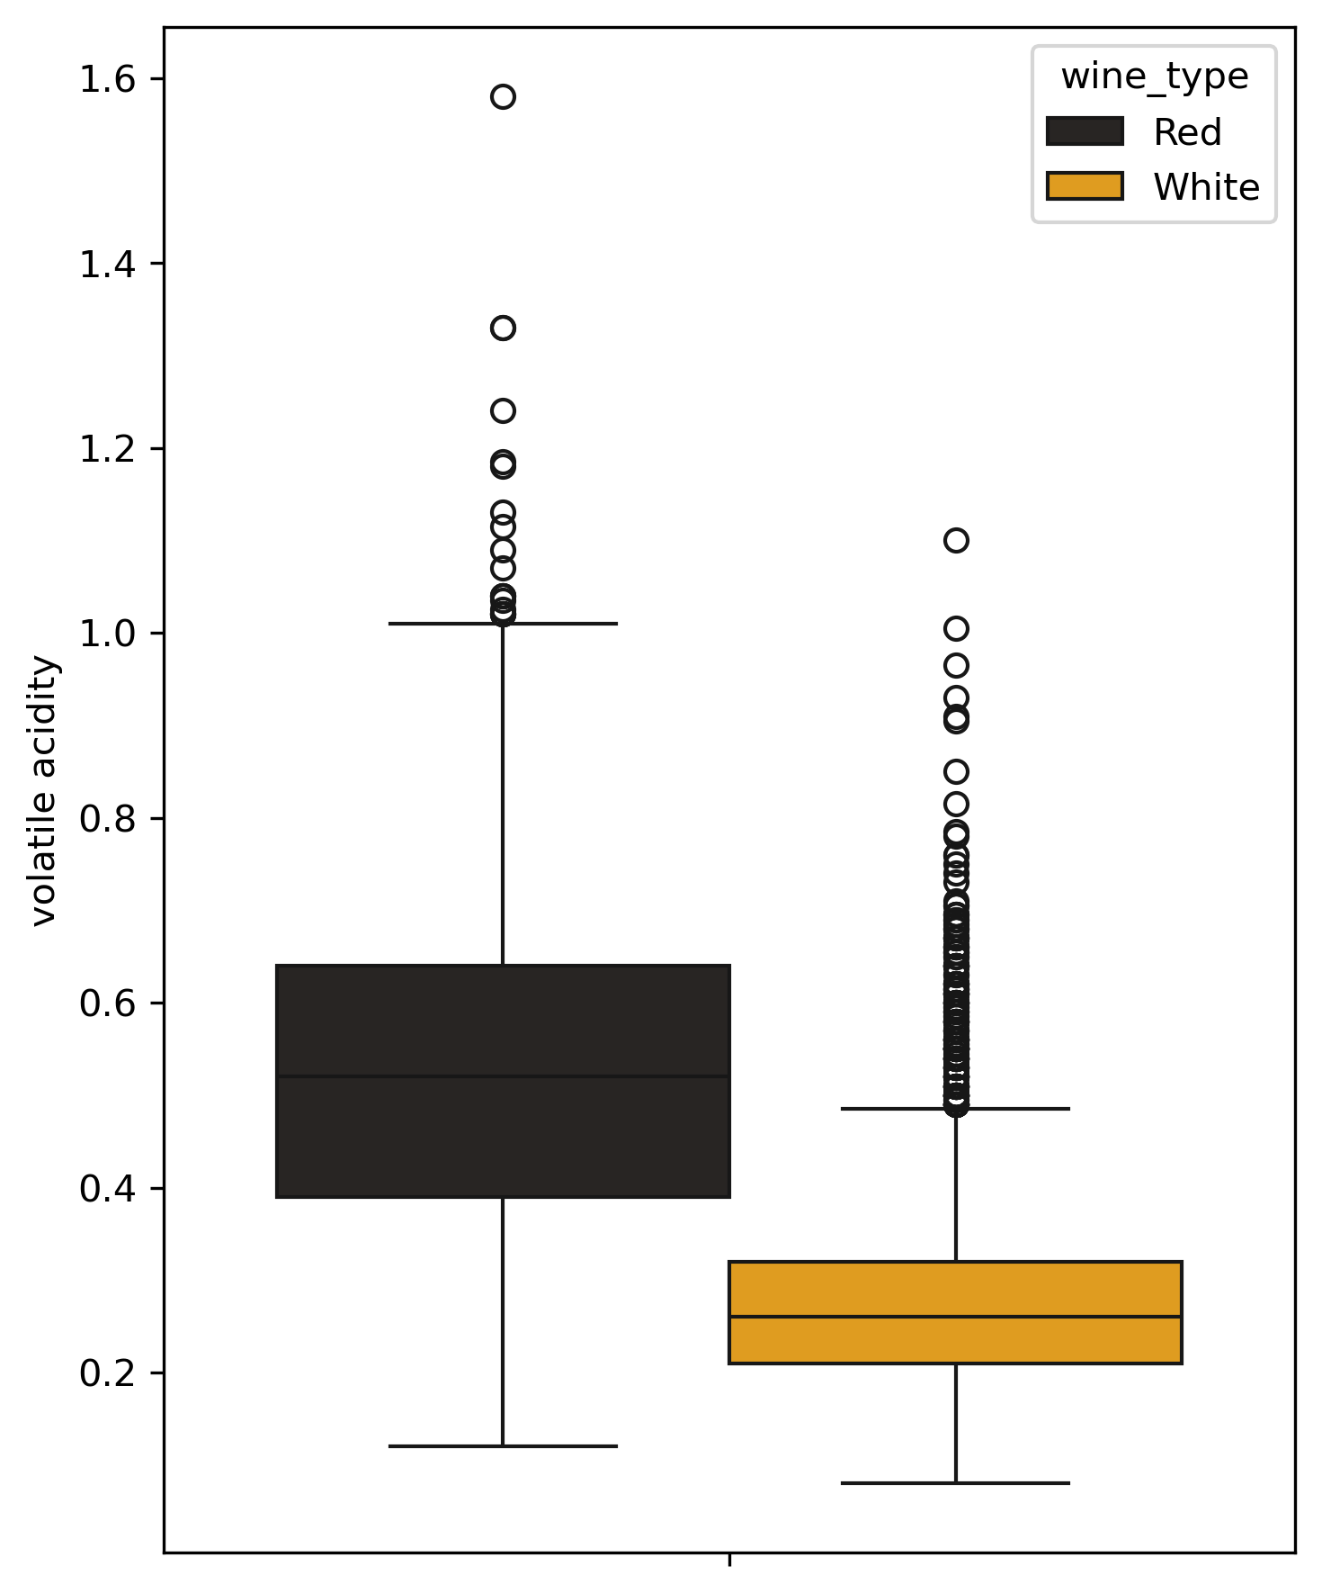
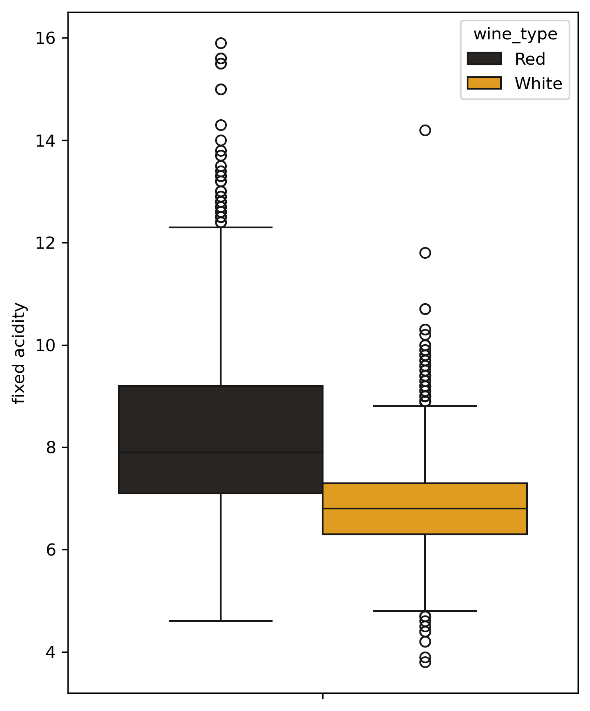
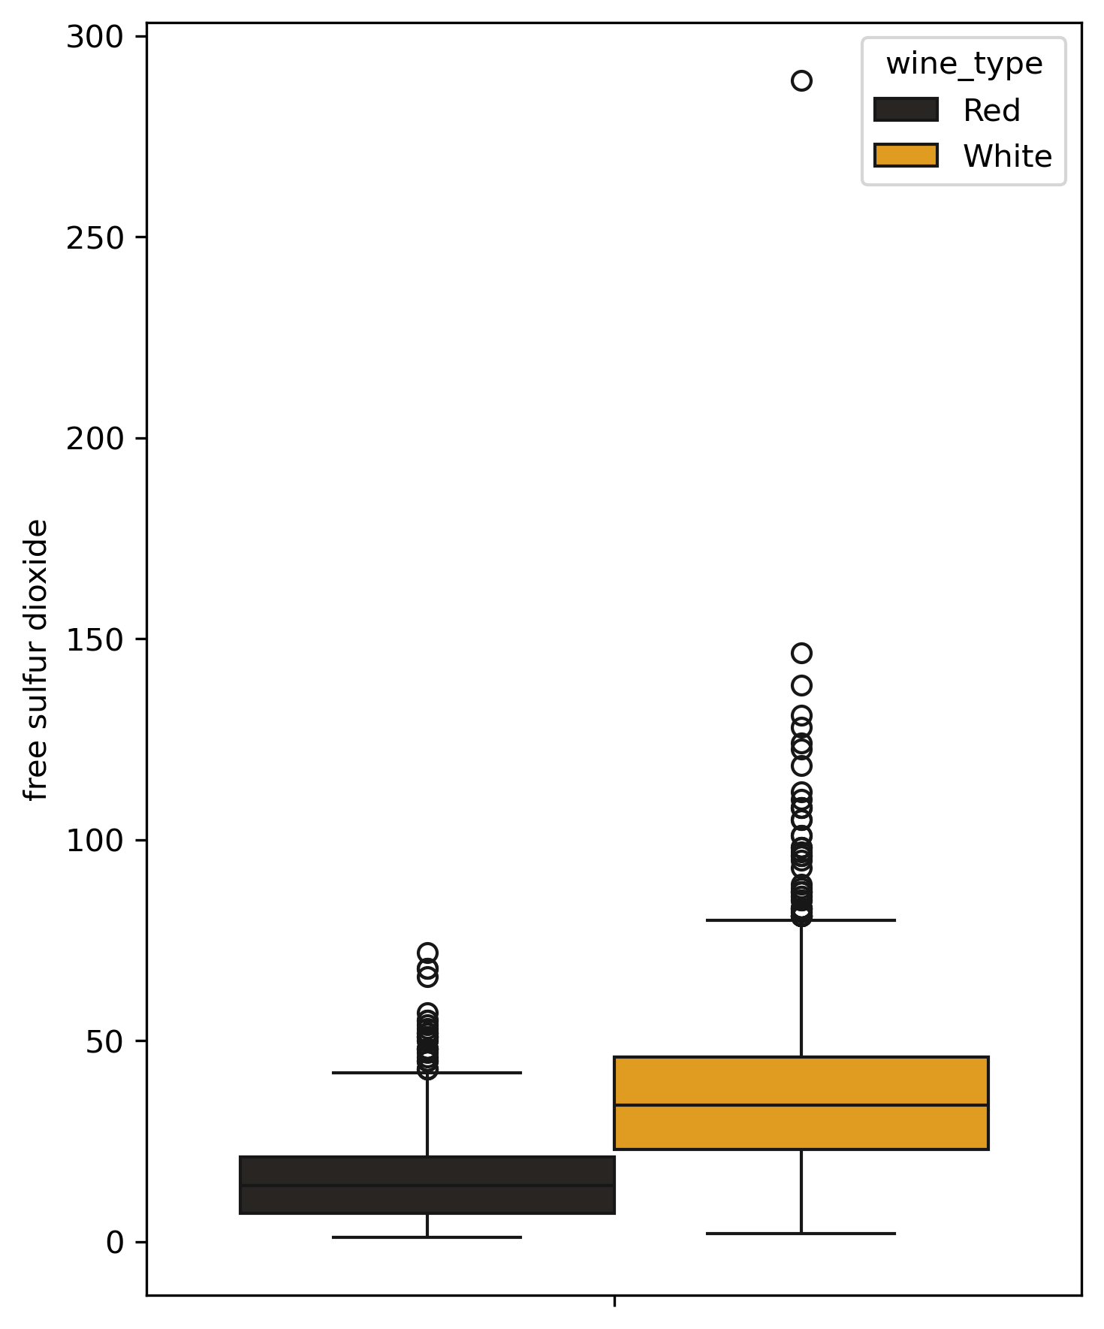
Comparisons Of Red And White Wines

Slide 7
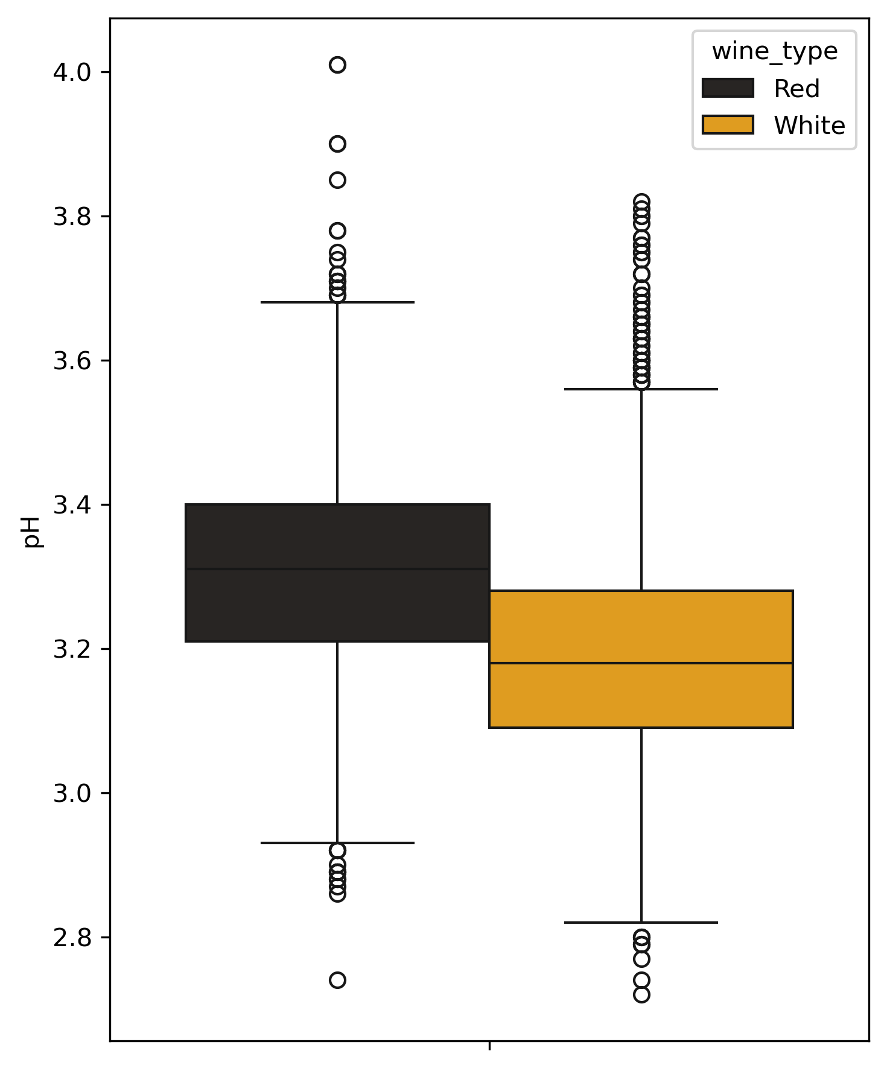
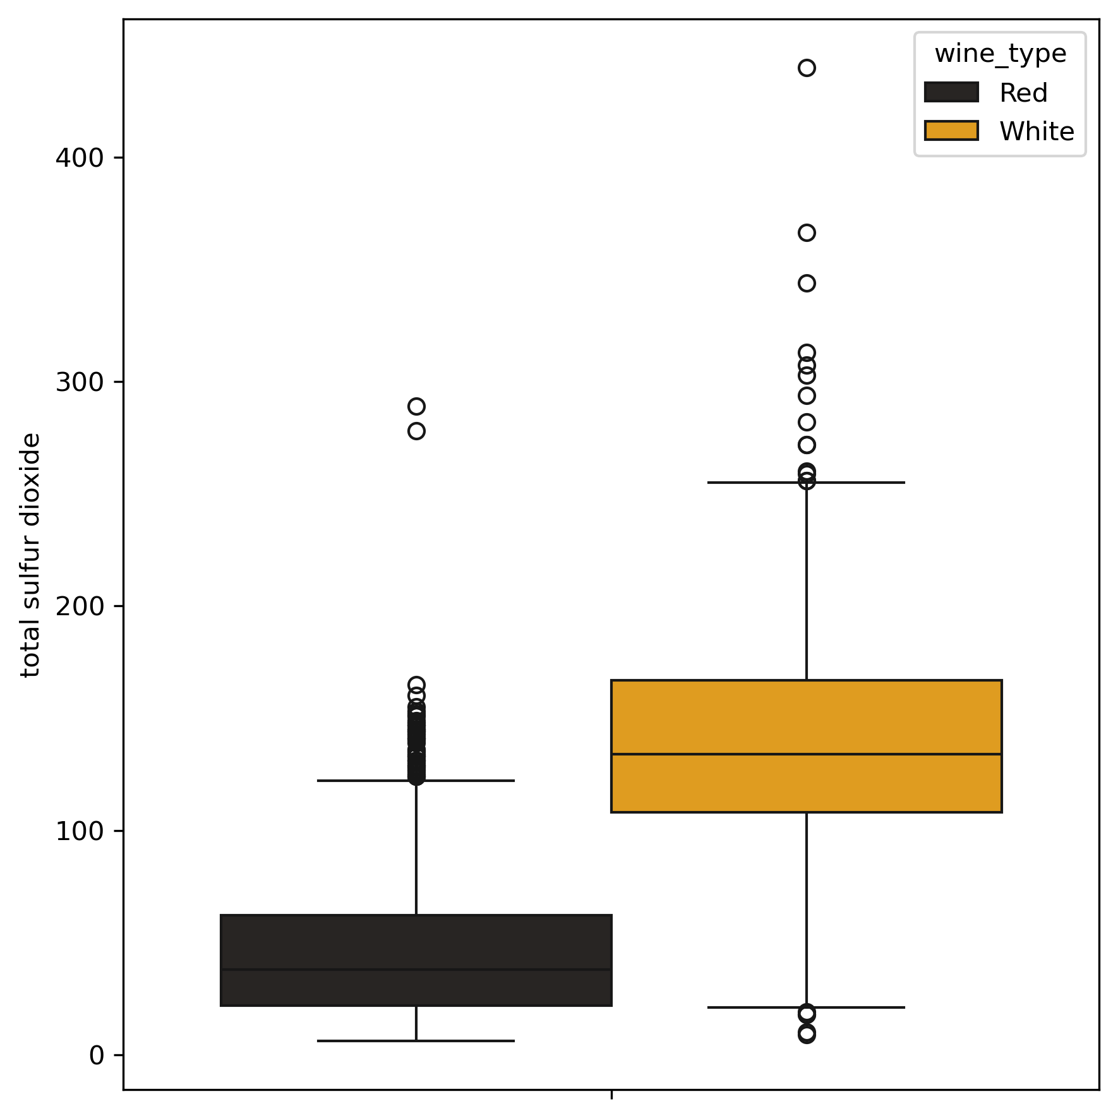

Slide 8
What Makes A Good Wine ?

Slide 9
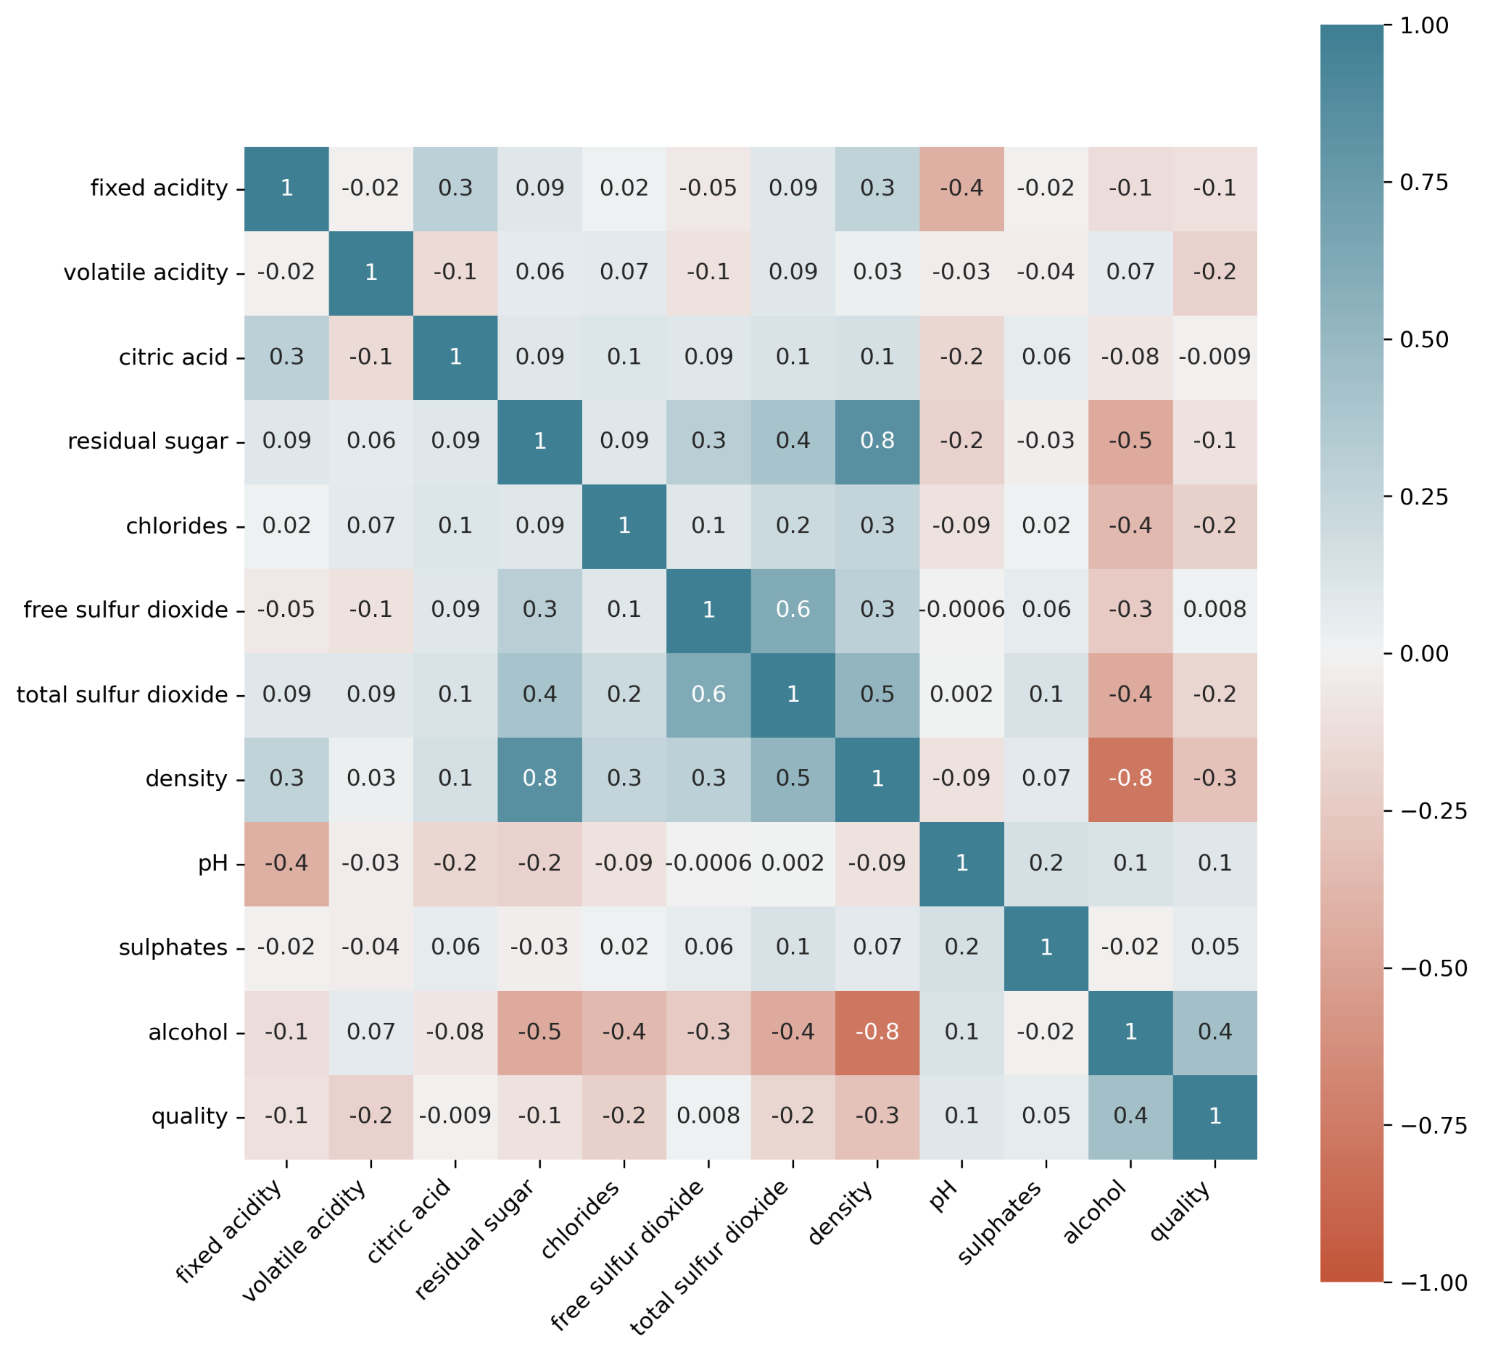
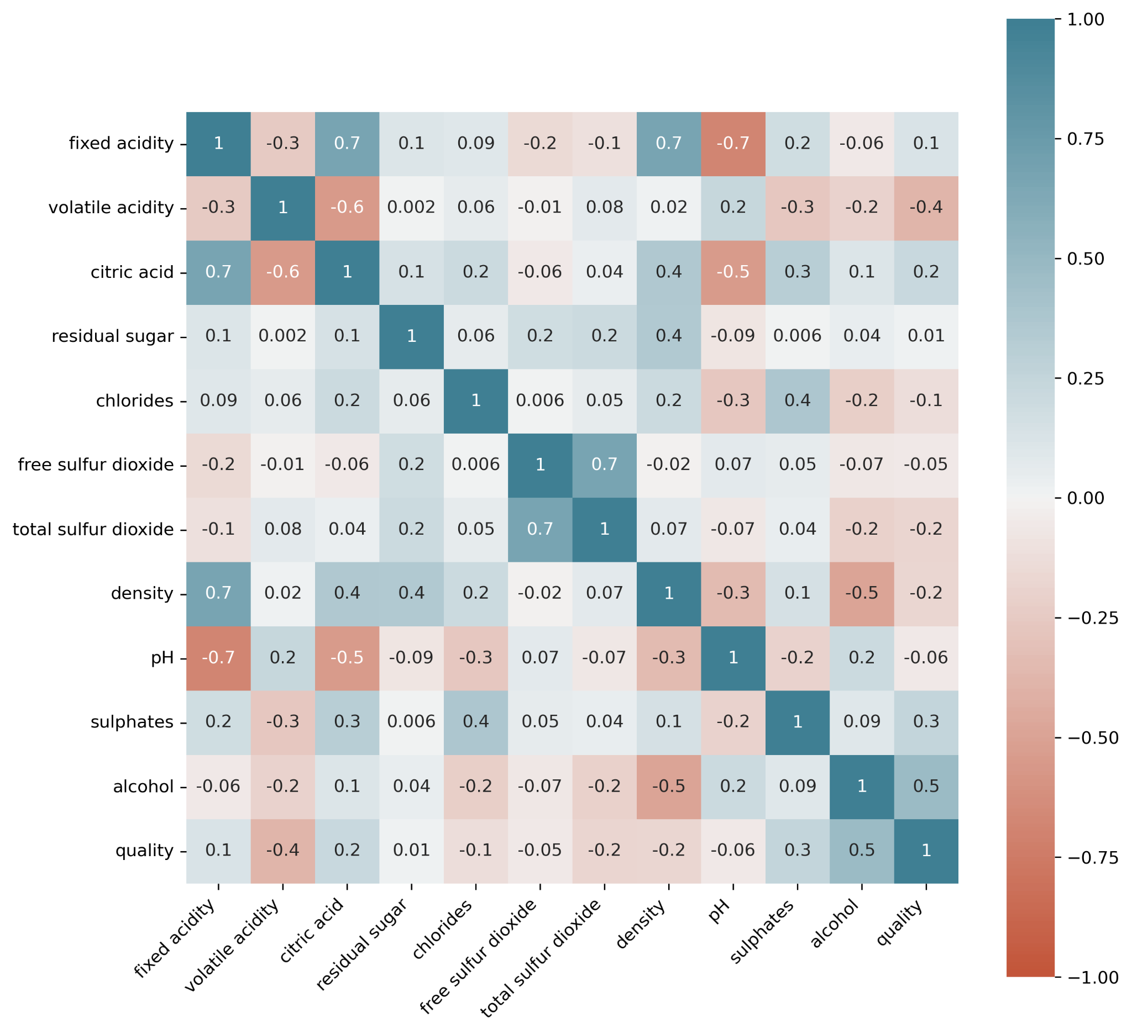
White Wine Heat Map
Red Wine Heat Map

Slide 10
Lower Correlated Patterns

Slide 11
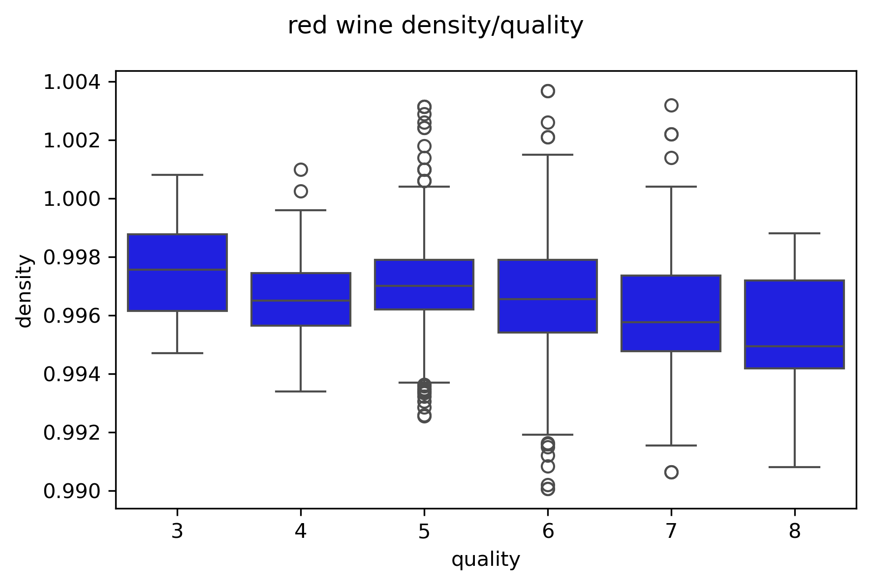
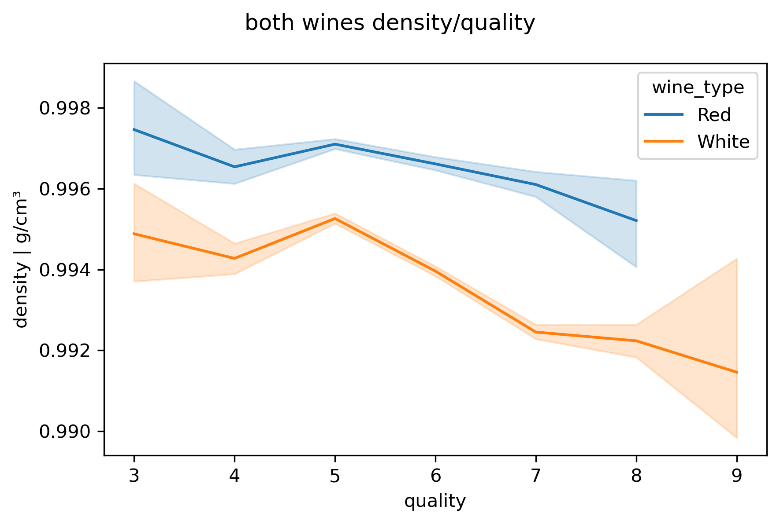
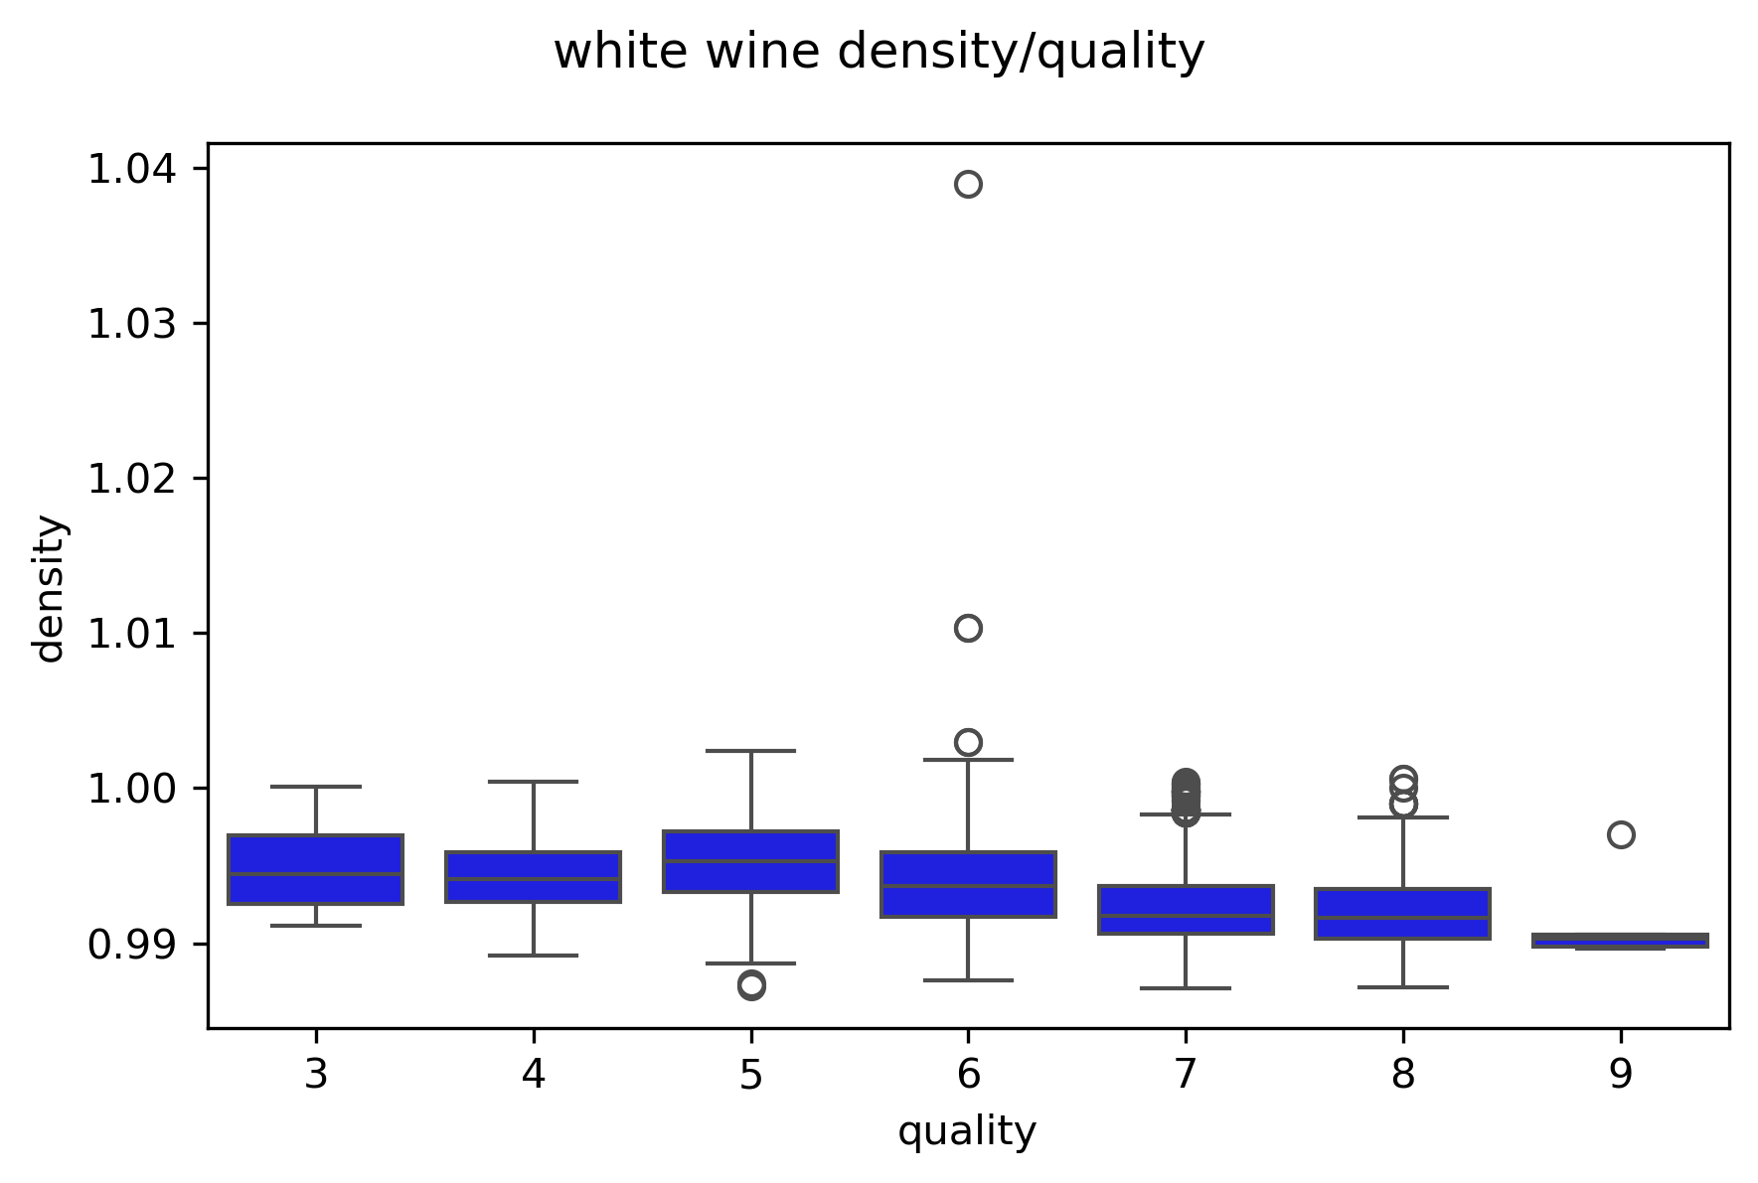
Impact Of Density On Wine
Notes:
Here we can see this is not a strong pattern
First can and last candle overlap
Show a direction but is not strong enough to be a quality maker
However since i have found a general direction, they should still side on caution and follow it
Talk about the bands

Slide 12
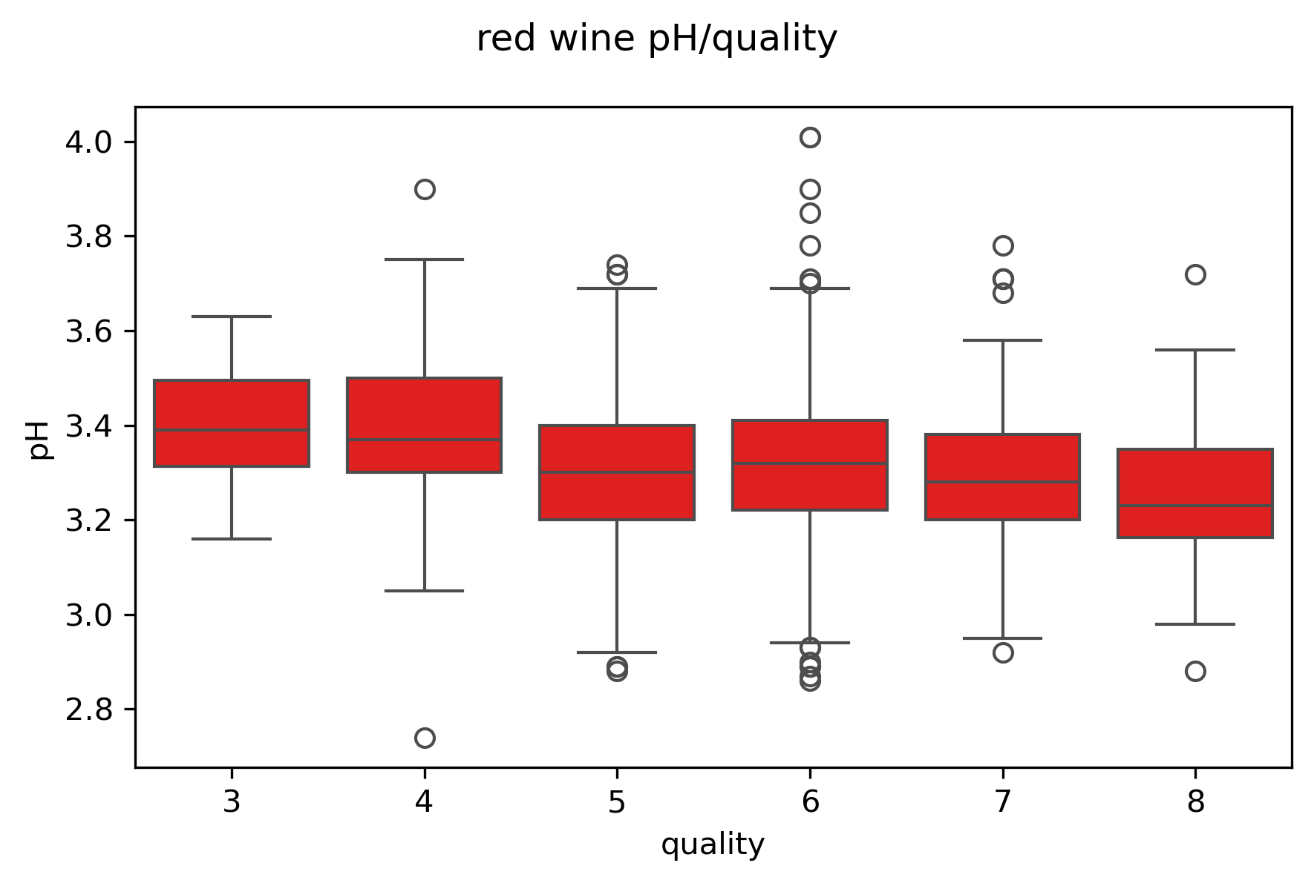
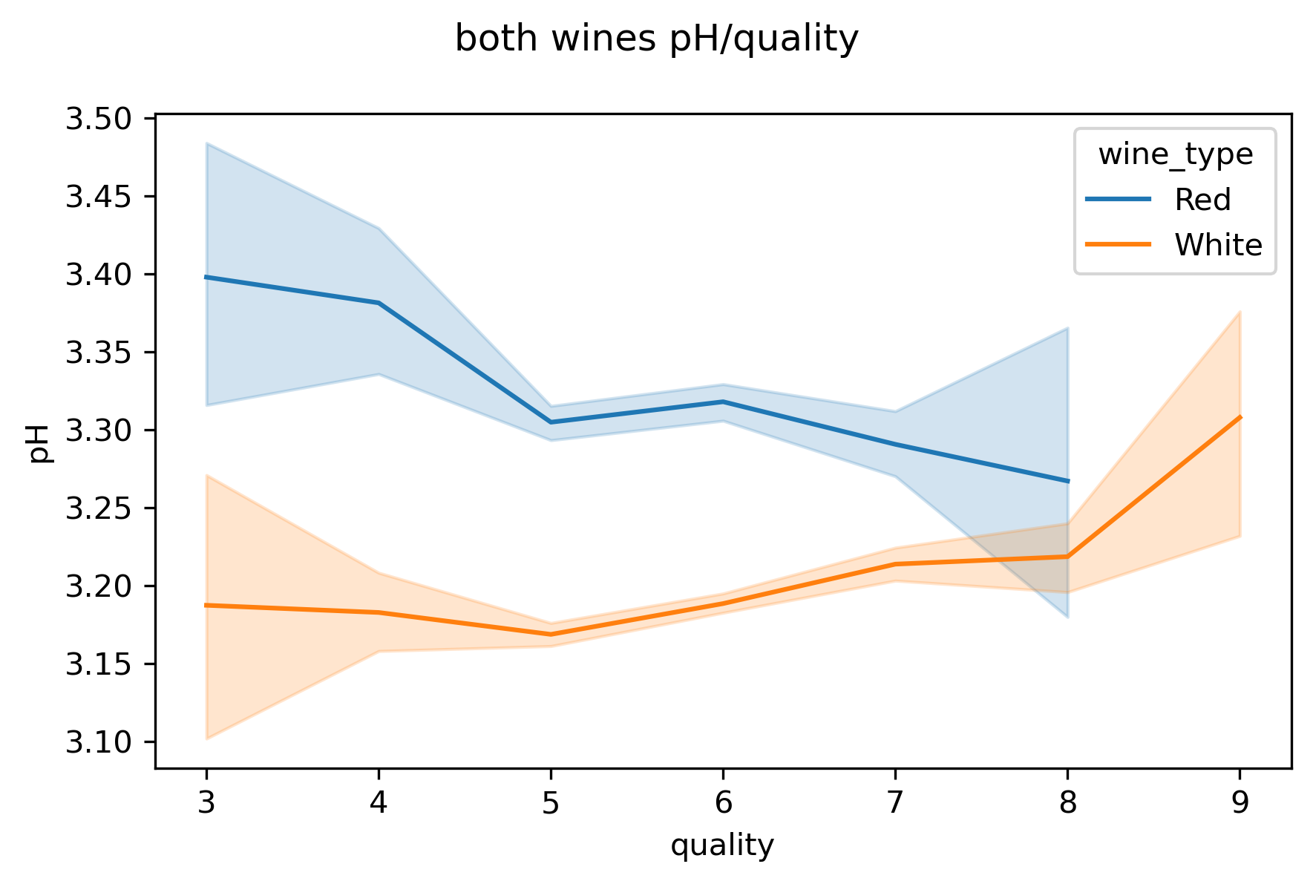
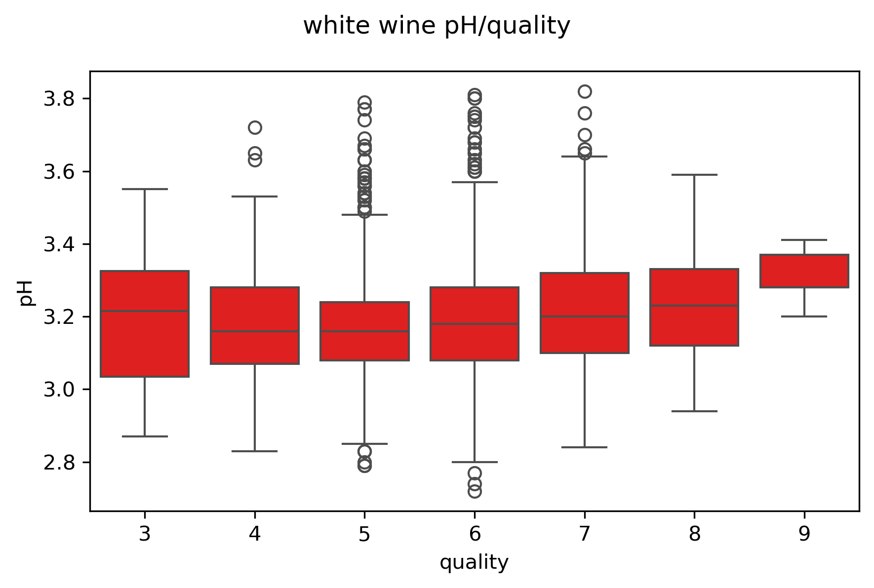
pH vs Quality and the impact on density
Notes:
Point of intersection
You should make you red wines more acidic and your white wines more basic
High variation
Review points from last slide

Slide 13
Higher Correlated Patterns

Slide 14
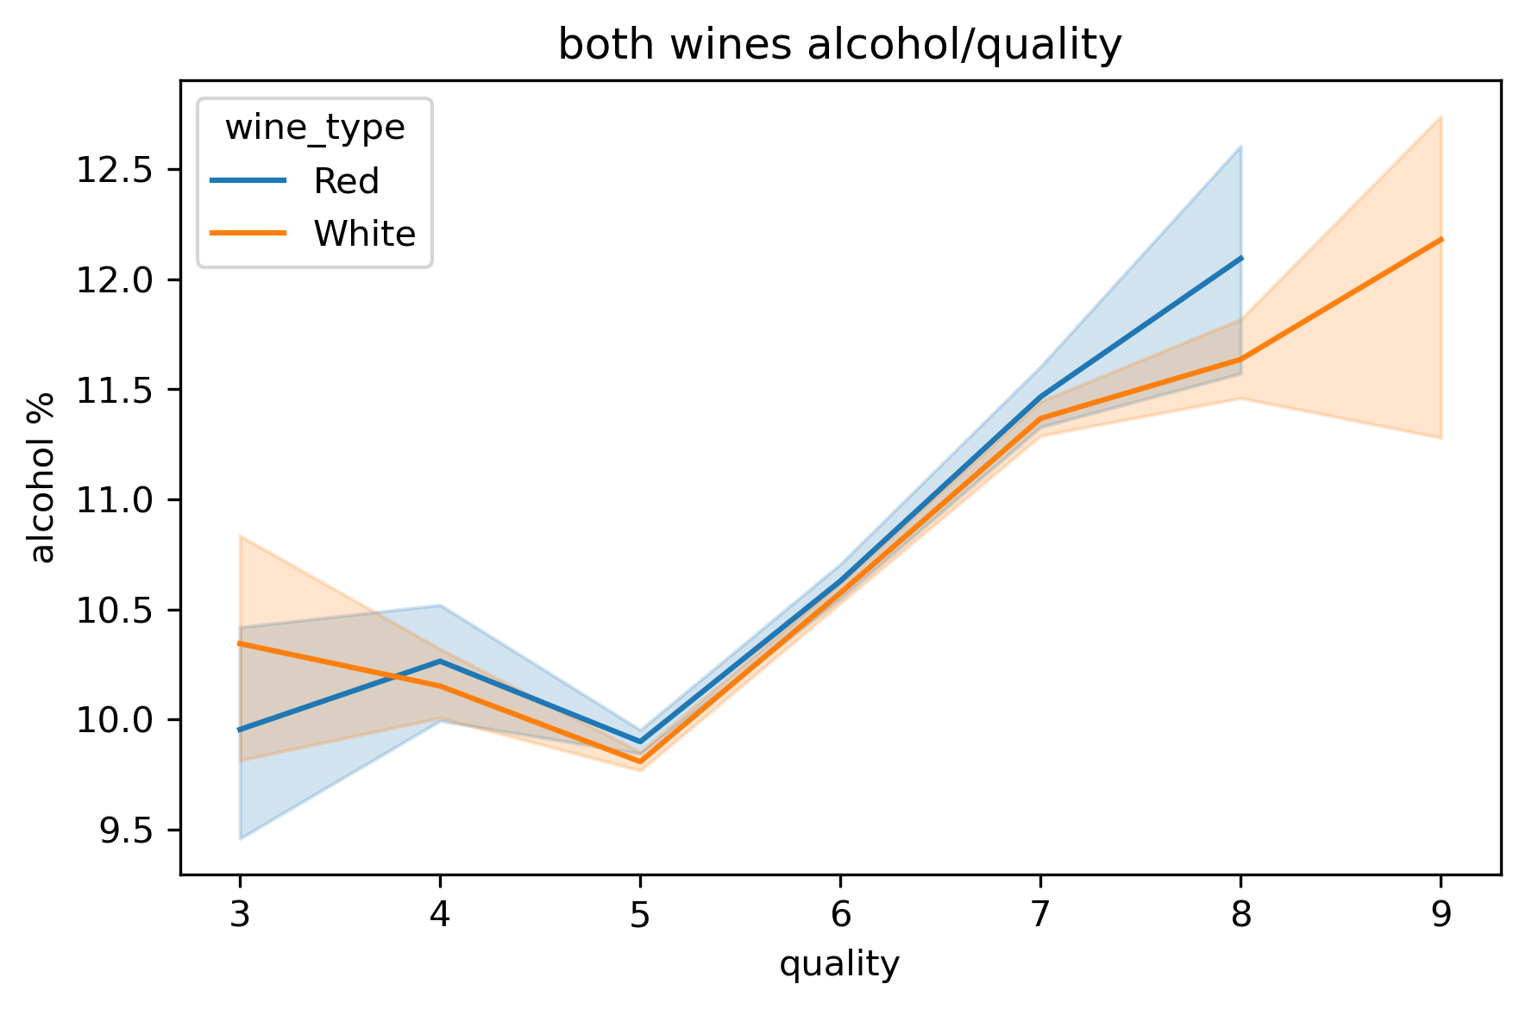
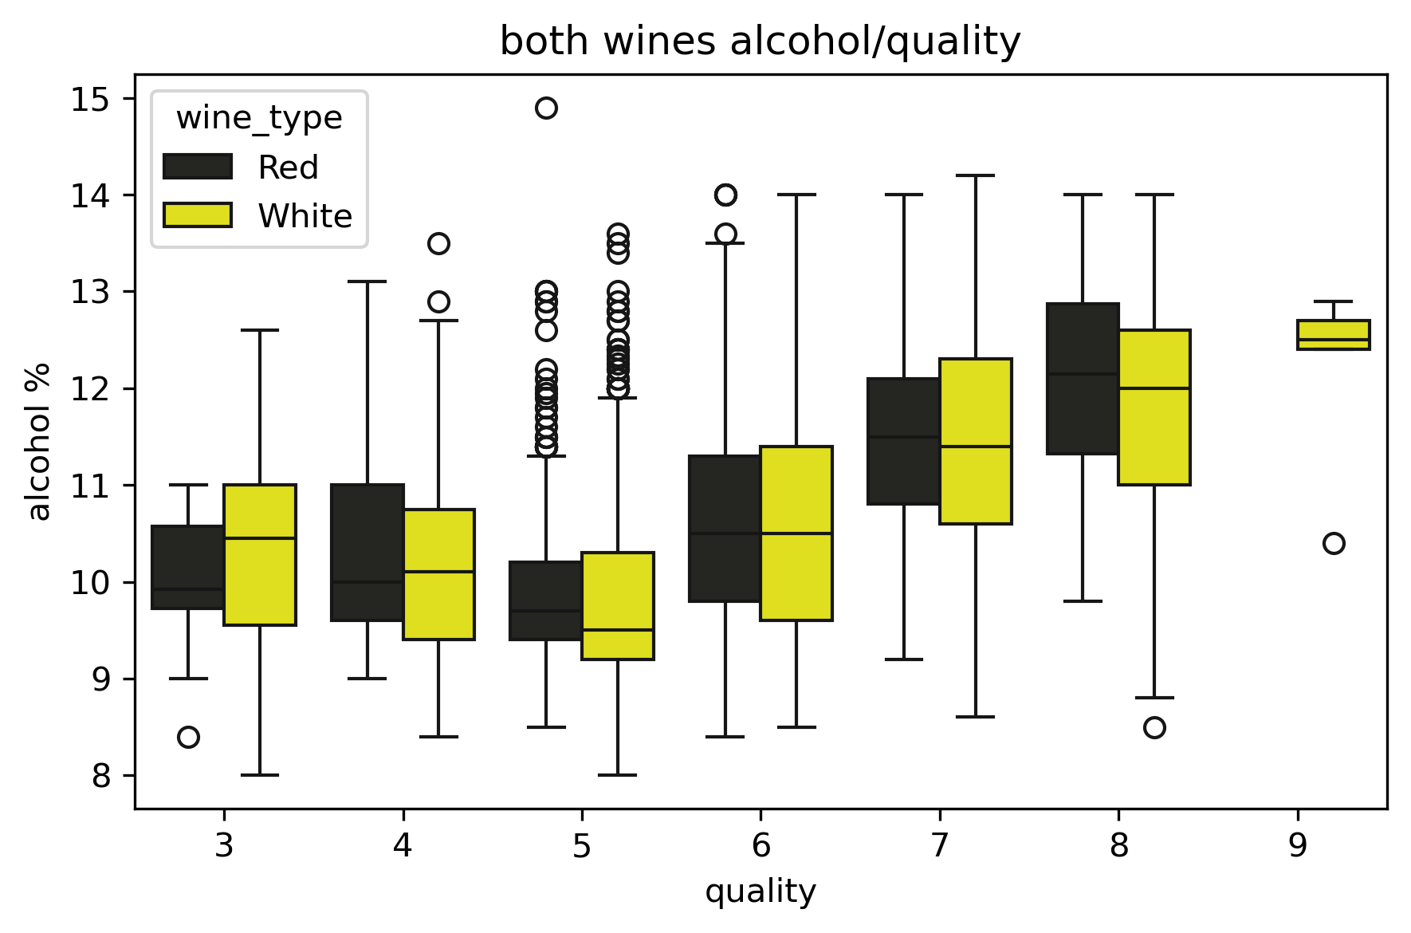
Impact of Alcohol on Wine Quality
Notes:
Alcohol improves quality for both wines
There isnt overlap between the first and last plot
High difference
Both follow a similar pattern
May be because of the distillation process that good quality wines end up with higher alcohol content

Slide 15
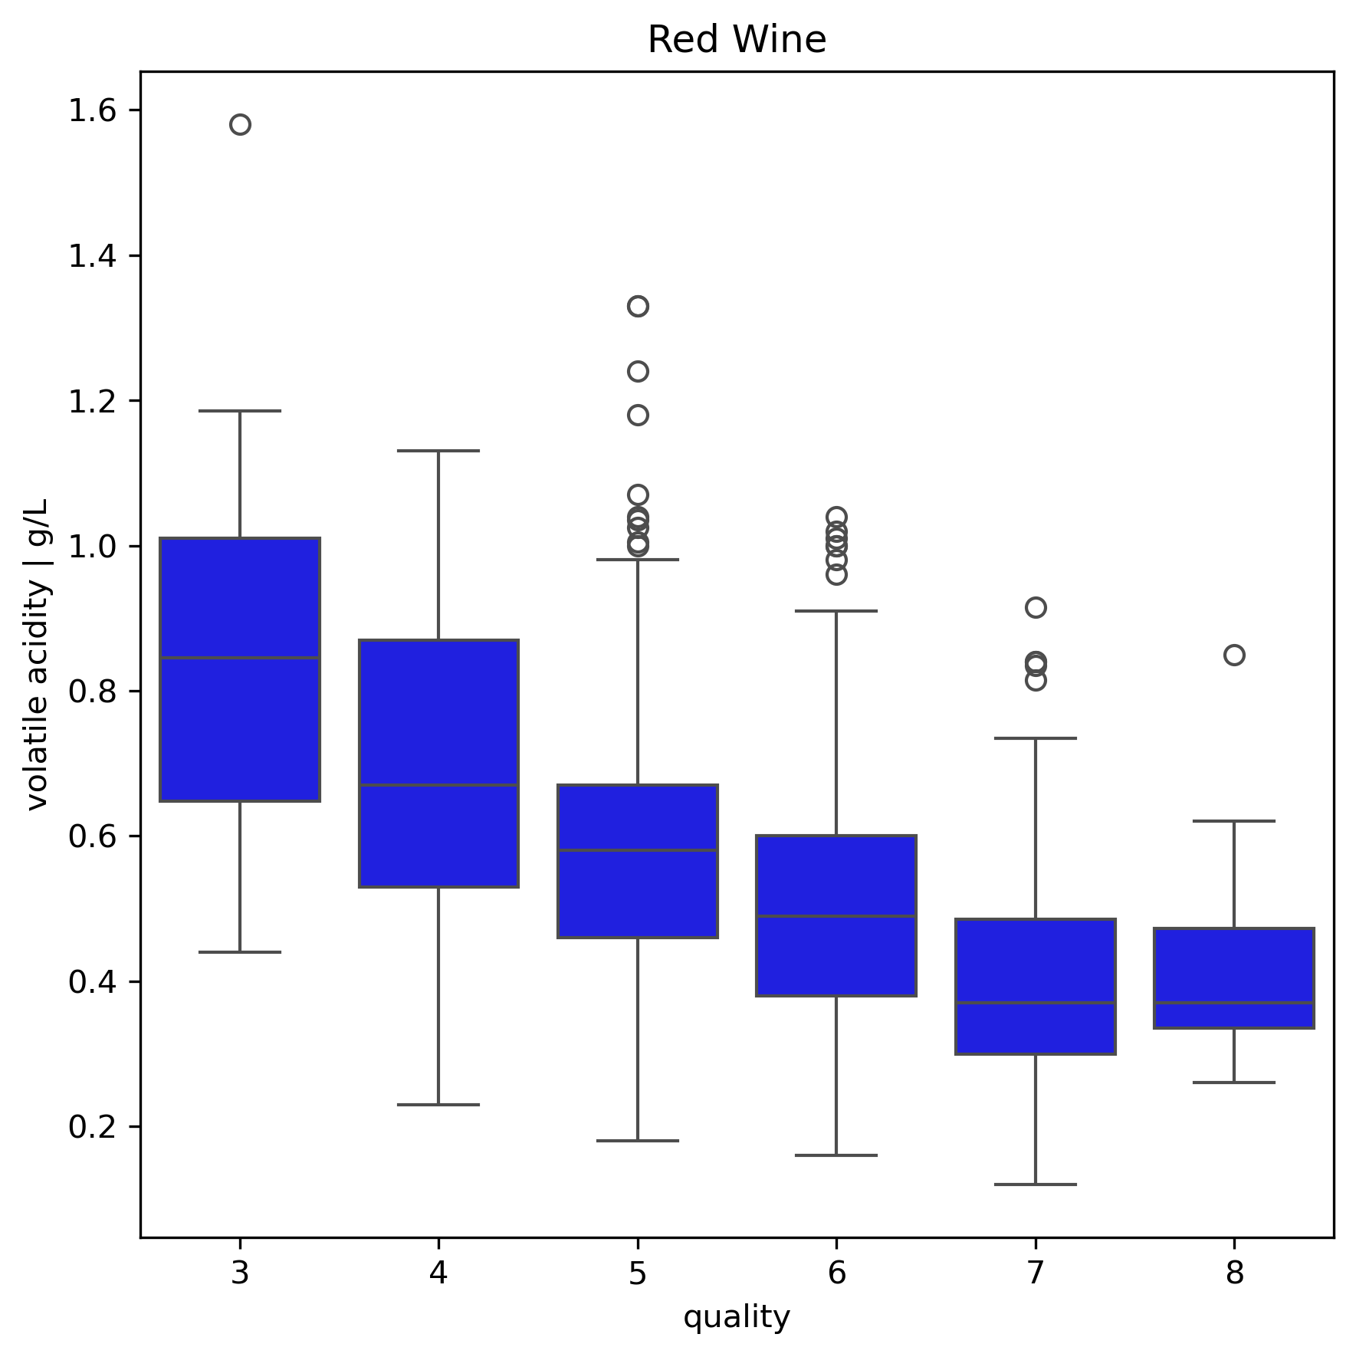
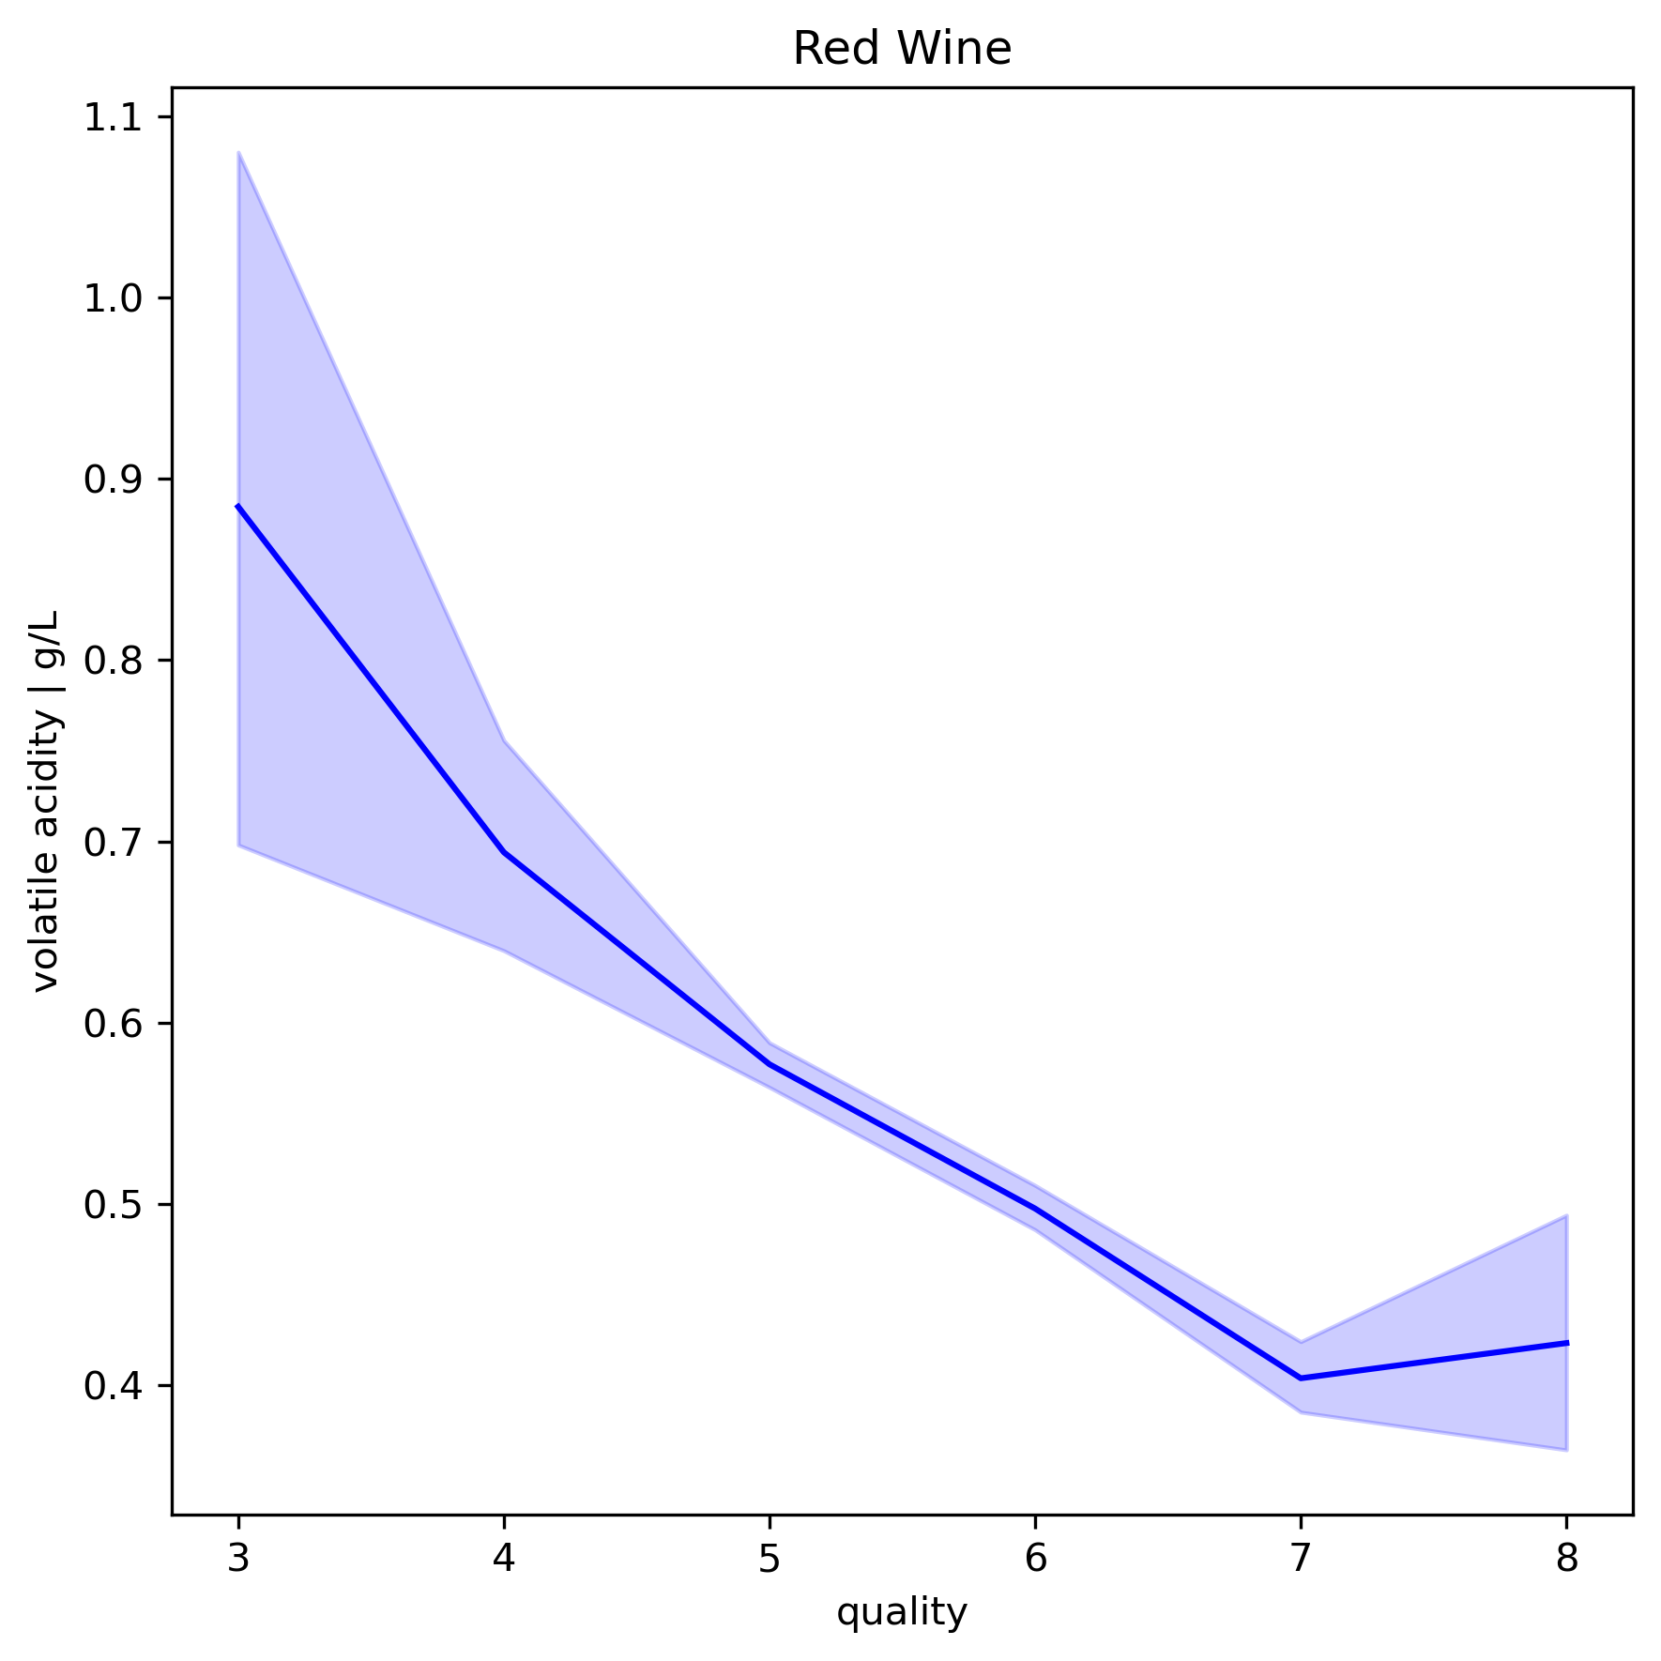
Volatile Acidity vs Quality For Red
Notes:
High difference low variation very strong pattern
Is a quality marker for red wine
This pattern must be followed and red wines must be made with less volatile acidity

Slide 16
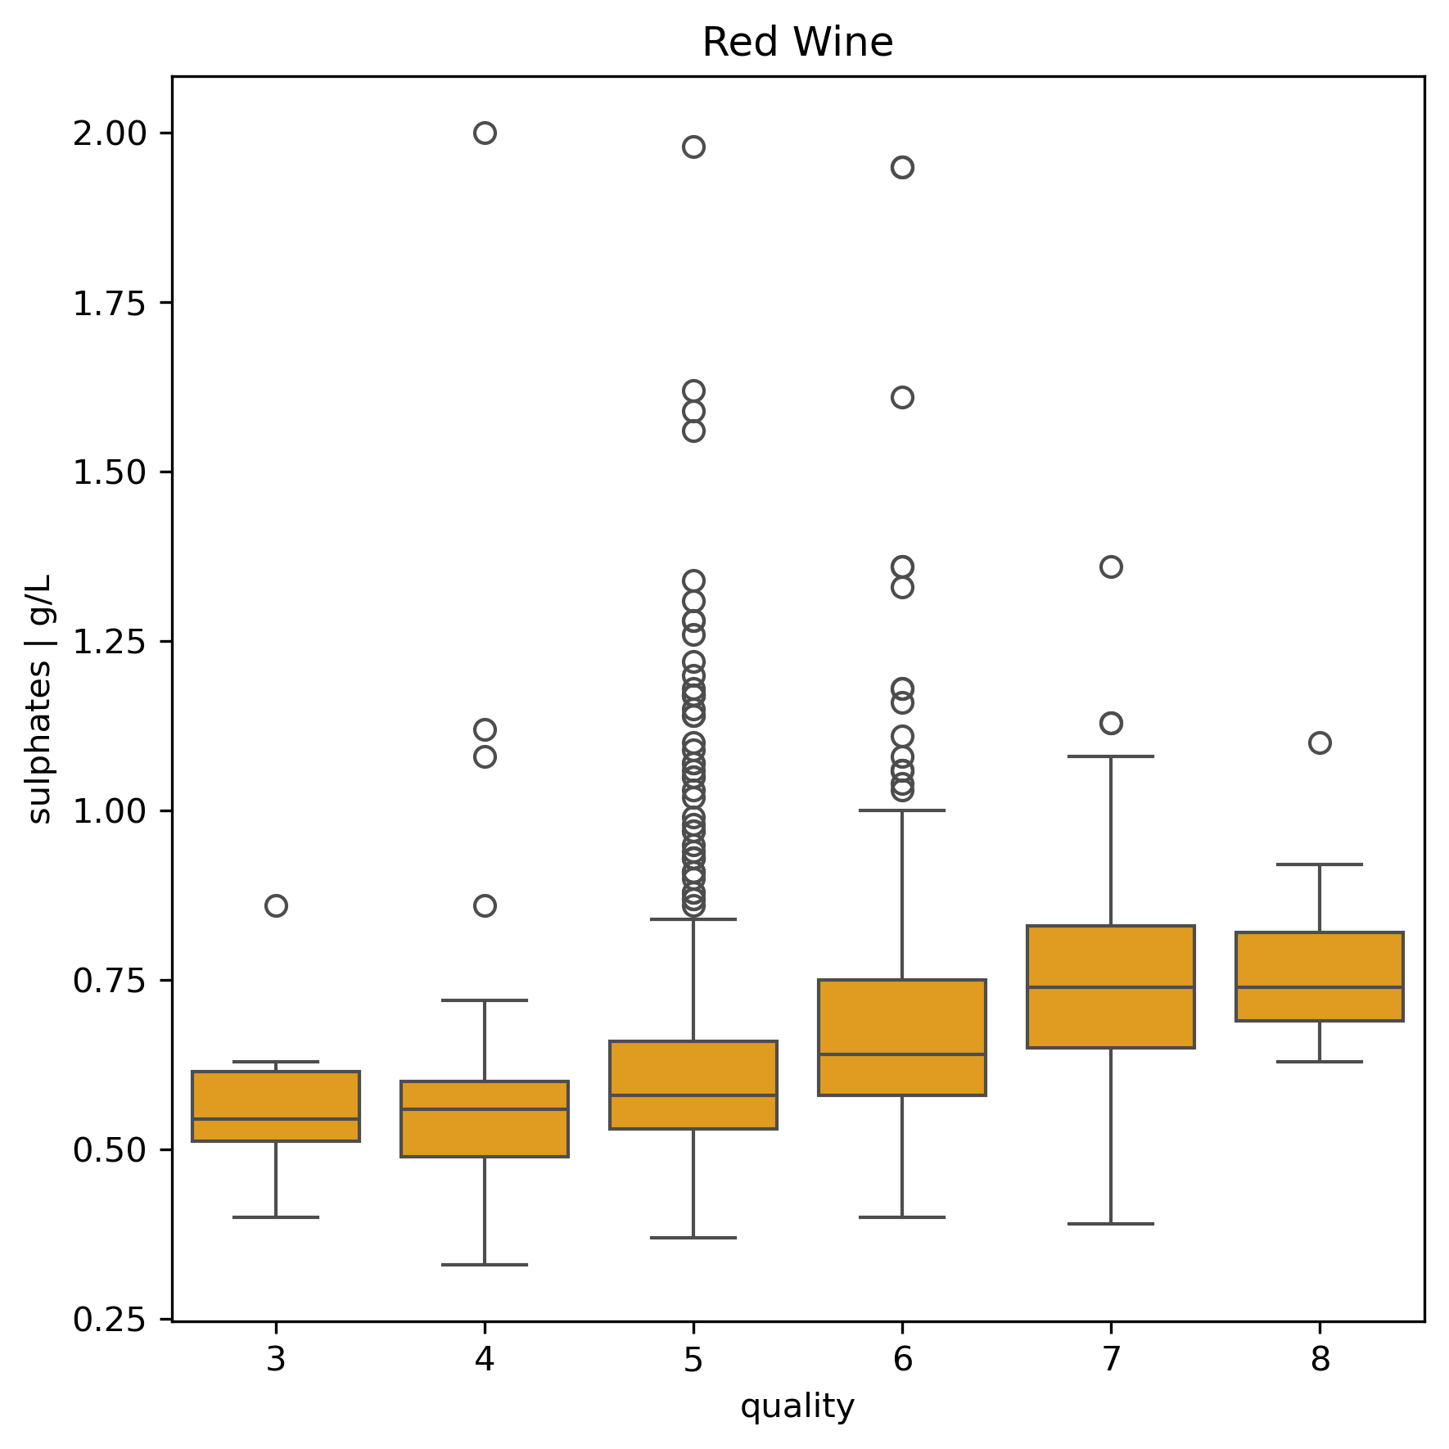
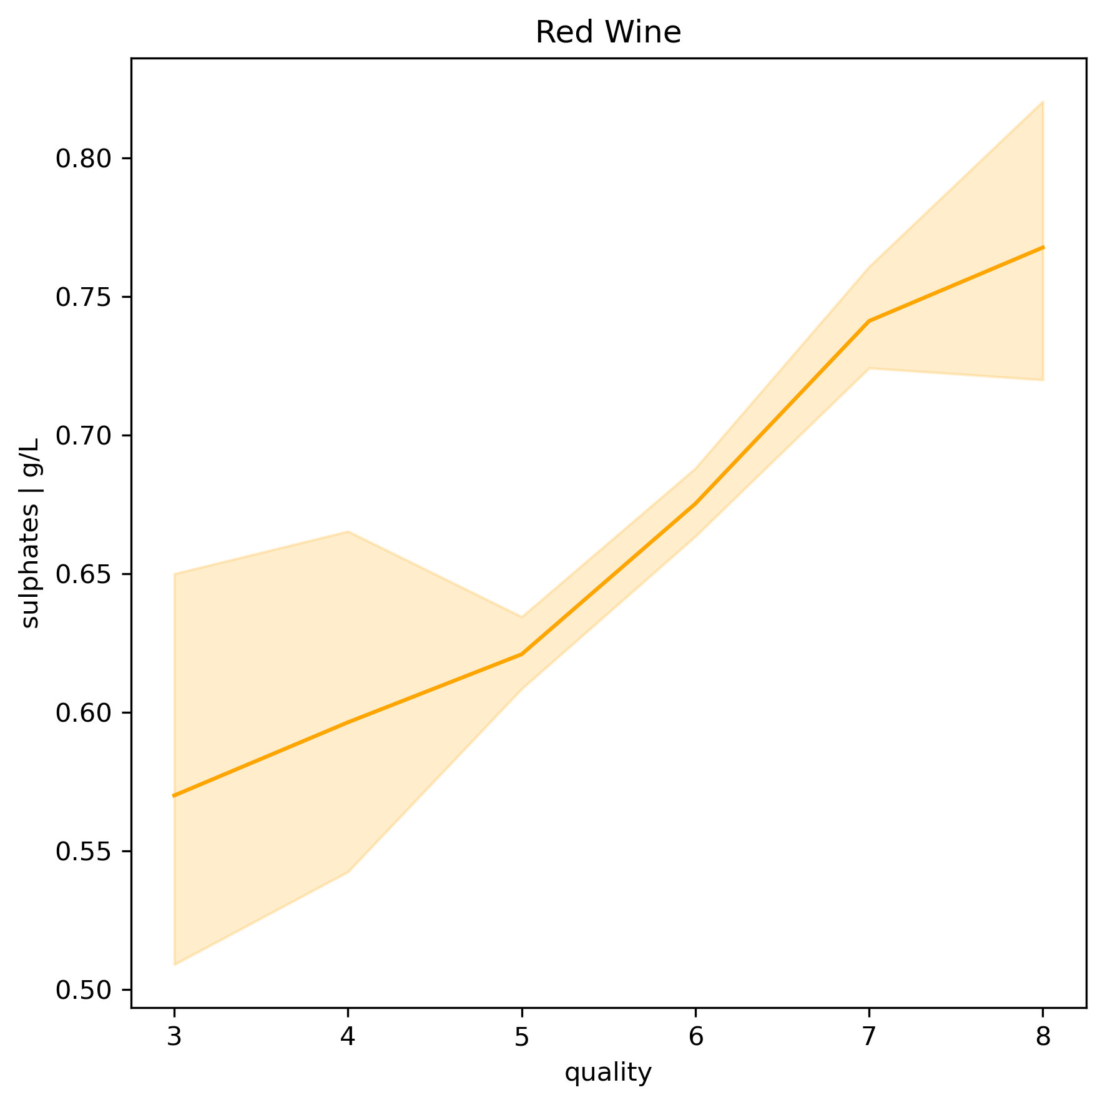
Impact Of Sulphates On Red Wine
Notes:
Shows a patterns
Is a medium strength pattern showing no overlap between the first and last but a little bit inbetween as well as high variance
The wine should still be made with more sulphates as there is a pattern of relative difference

Slide 17
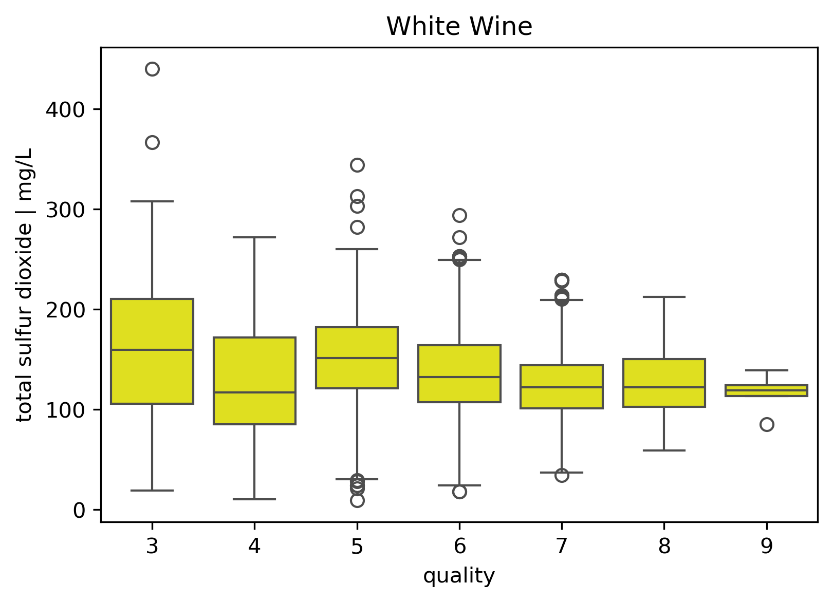
White Wine Total Sulfur Dioxide Variance
White wine should be made within a certain target of total sulfur dioxide as is seen here around 100 - 150 mg L.
Perhaps the distillation process for quality wines naturally results in sulfur dioxide levels falling within this range.
Notes:
White wine should be made within a certain target of total sulfur dioxide as is seen here around 100 - 150 mg L
May be because good wines distillation always makes the wine end up with a sulfur dioxide content in this range

Slide 18
Machine Learning Results

Slide 19

How Did I Build It ?
Data Preparation:
Handle Outliers
Feature Selection: Remove low-importance features e.g., citric acid
Data Normalization:
Use Standardization or Min-Max Scaling
Used smote and hypertuning but didn't work
Model Training:
Algorithms: Decision Trees, Random Forests, XGBoost
Cross-Validation for performance
Hyperparameter Tuning to optimize

Slide 20
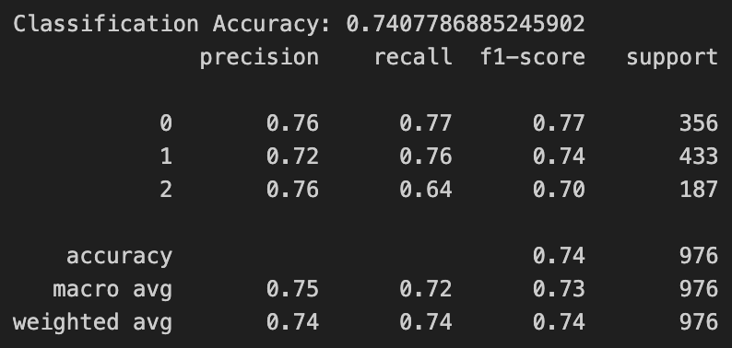
White Wine Machine Learning Model

Slide 21
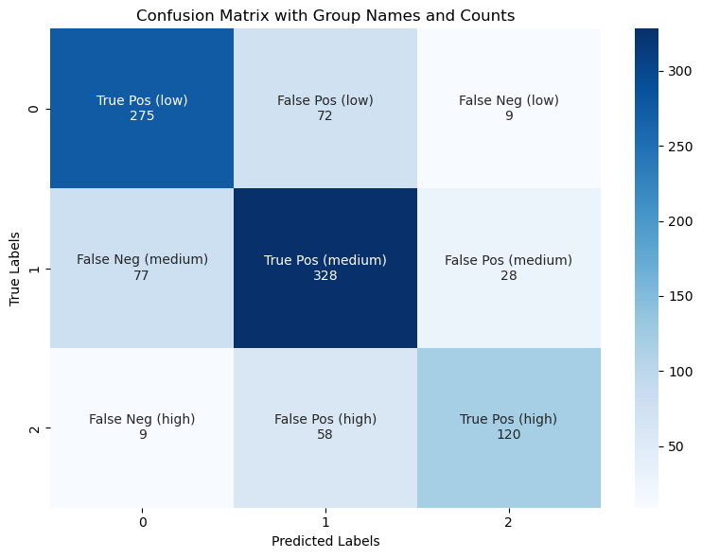
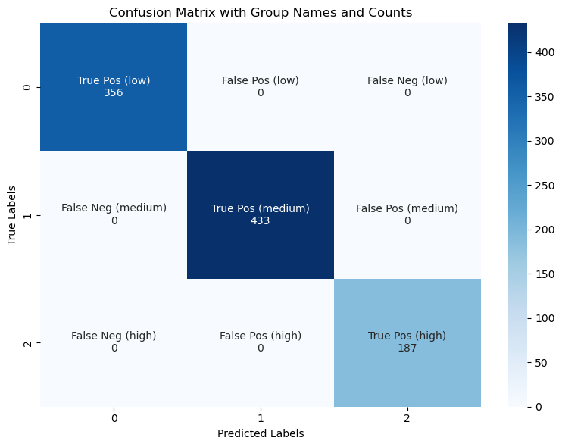
Confusion Matrix White Wine
Mine
Perfect unattainable model

Slide 22
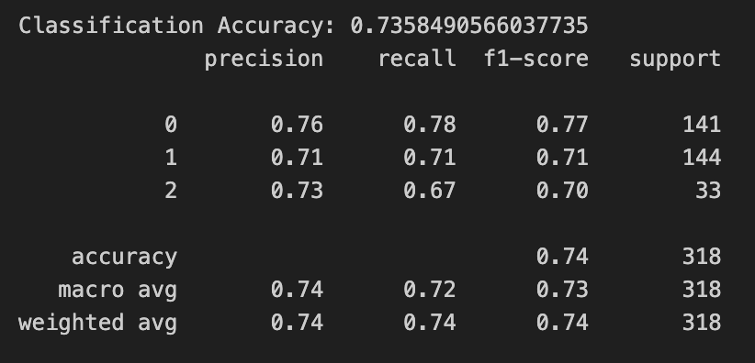
Red Wine Machine Learning Model

Slide 23
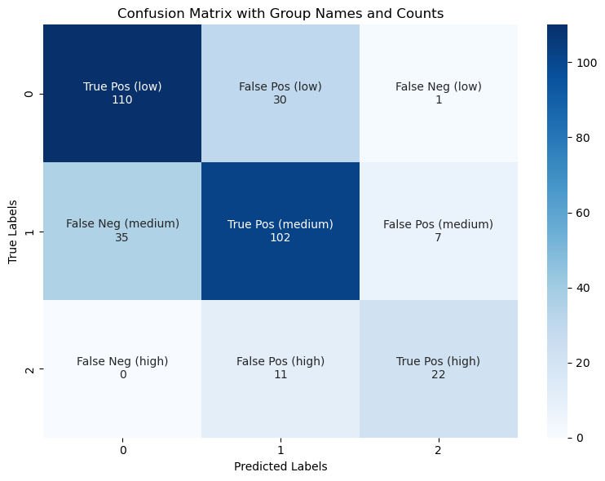
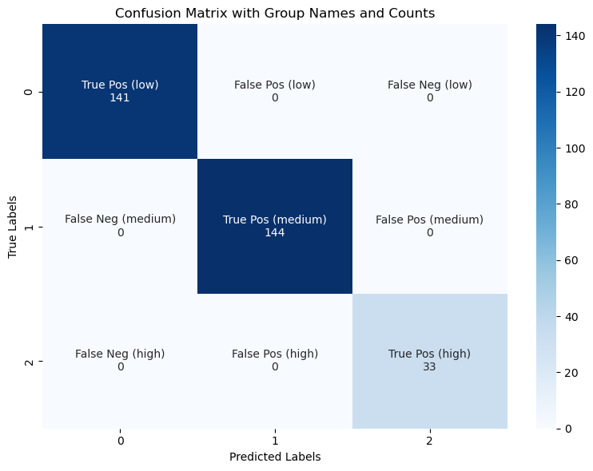
Red Wine Confusion Matrix
Mine
Perfect unattainable model

Slide 24
Conclusion
Project Summary
Built a model to classify wine quality into low, medium, and high categories using key features such as pH and alcohol content.
Used class imbalance with SMOTE that failed and optimized the Random Forest Classifier using GridSearchCV, which worked to little effect.
Key Results
Achieved 74% accuracy, with strong F1-scores across all categories.
The confusion matrix indicated good separation for low and high quality wines, but some confusion with the medium category.
Next Steps
Explore more advanced models like XGBoost for better accuracy.
Incorporate additional features for improved predictions.
Potential application for winemakers in assessing wine quality quickly.

